Slide 1

Macroeconomics II
Lecture 02 (Feb 2023)
A map of the early theories of growth
The classical school
Accumulation and distribution
1

Slide 2
Lecture 02
Cap. 02 Theories of economic growth: the classical school and some milestones
classical thought on endogenous growth: Adam Smith (1776), David Ricardo (1817), Karl Marx (1867).
Accumulation, the essence of capitalism
Reading
Louçã and Mortágua (2021), Chapter 3.
2

Slide 3
classical thought on endogenous growth
political economy emerges in the context of the Industrial Revolution (mid-18th century, UK): inquires the factors of (economic) growth of nations, and the role of manufacturing industries in “explaining” it. The accumulation of capital plays a central role in the process of growth of production.
Adam Smith (1723-1790), David Ricardo (1772-1823), Thomas Malthus (1766-1834), Karl Marx (1818-1883)
Adam Smith,
1759, Theory of Moral Sentiments
1776, An Inquiry into the Nature and Causes of the Wealth of Nations.
Thomas Malthus,
1798, An Essay on the Principle of Population
David Ricardo
1817, On the Principles of Political Economy and Taxation
Karl Marx
1867, Capital
3

Slide 4
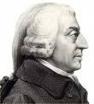
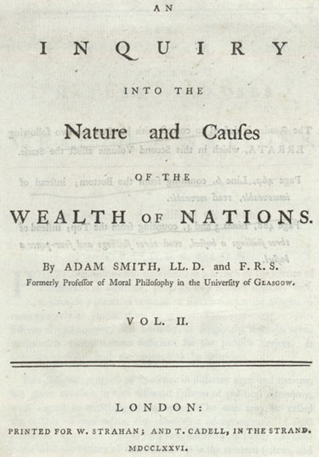
Adam Smith (1723-1790)

Slide 5
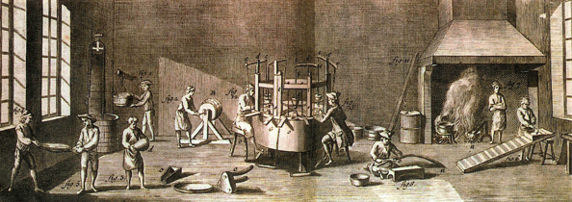
Adam Smith and the pin factory
1 worker, 20 pins; but, after a new division of labour, 10 workers produce 48 thousand pins

Slide 6
Dynamic principles in Adam Smith
Division of labour, evolution of productivity and new production techniques
Social classes, growth and distributions
Capital accumulation
Institutions: government, taxes, public services
Theory of value based on cost of production

Slide 7
Adam Smith (1723-1790)
Economic Growth is an endogenous process, depending on decisions of the economic actors (savings, investment) and the endogenous creation of new ideas and knowledge (new products and/or new production methods).
The per capita income depends on the labour productivity (“skill, dexterity, and judgement with which its labour is generally applied”).
The explanation of the growth of labour productivity is the division of labour (either within and between firms), depending on the accumulation of capital and on the size of the market
Technical progress is relevant, propelling the accumulation of capital as the major engine of this process. It is generated within the economic system; the new technical knowledge is a public good (non rival; non exclusion).
7

Slide 8
Adam Smith, The Wealth of Nations
“What is bought with money or with goods is purchased by labour as much as what we acquire by the toil of our own body. That money or those goods indeed save us this toil.
They contain the value of a certain quantity of labour which we exchange for what is supposed at the time to contain the value of an equal quantity.
Labour was the first price, the original purchase-money that was paid for all things. It was not by gold or by silver, but by labour, that all the wealth of the world was originally purchased; and its value, to those who possess it, and who want to exchange it for some new productions, is precisely equal to the quantity of labour which it can enable them to purchase or command.”

Slide 9
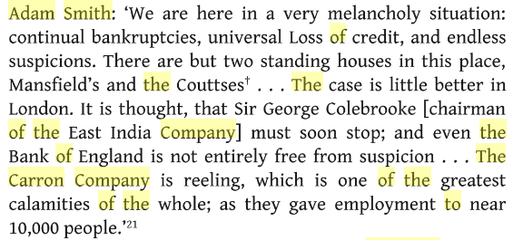
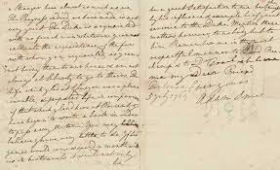
Letter by David Hume (1711-1776) to Adam Smith
“Or will you revise some chapters?” (27 June 1772)

Slide 11
David Ricardo (n. 1772) (On the Principles of Political Economy and Taxation, p. 1817)
income distribution is a crucial factor of economic growth, as the major constraint, or
positive factor, for economic growth;
law of diminishing returns in agriculture production as a crucial factor.
then, agriculture prices rises; the subsistence level of wages rises as a consequence; the agriculture producers who use more fertile lands generate abnormal profits, which are rents for the land owners;
as a consequence, the share of profits in total income tends to decrease;
solution: long-term (technical progress) or short-term (trade liberalization, to increase the imports of corn, originating lower agriculture prices and, then, reducing subsistence wage.
11

Slide 12
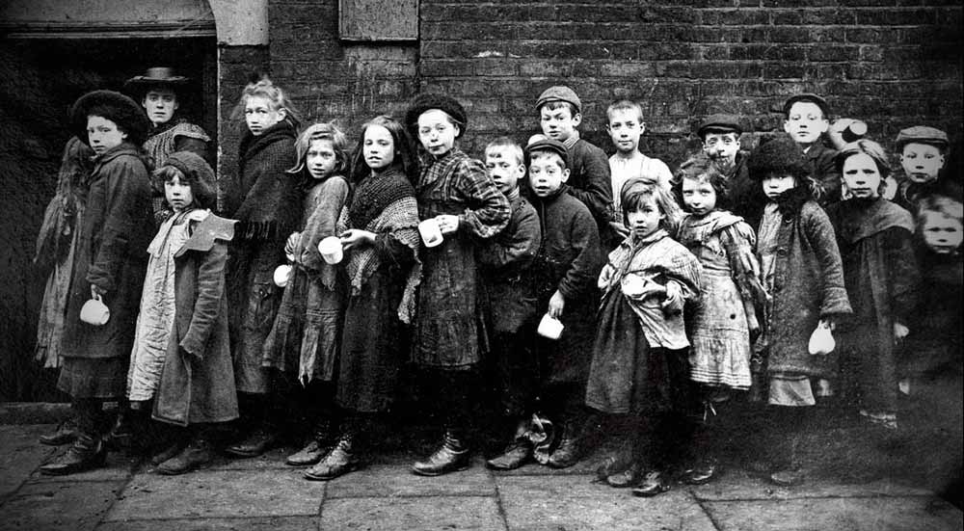
David Ricardo (1772-1823) (cont.)
His major concern has been income distribution (and not its growth).
Assuming the average wage as a constant, the capital accumulation raises the use of
land, with decreasing returns, originating the rise of the land rents and, then,
the profit rate becomes lower.
If profit rate decreases, the rate of accumulation reduces and the economy tends towards
a stationary state.
Therefore, the capital accumulation is endogenous.
The wage rate is a variable that regulates labour supply and demand: when capital accumulation
rises, the wage rate becomes higher than the natural wage and, then, labour
supply increases. Therefore, labour is not a constraint to the economic growth: economic
growth is endogenous.
12

Slide 13
David Ricardo (n. 1772) (On the Principles of Political Economy and Taxation, p. 1817)
income distribution is a crucial factor of economic growth, as the major constraint, or
positive factor, for economic growth;
law of diminishing returns in agriculture production as a crucial factor.
then, agriculture prices rises; the subsistence level of wages rises as a consequence; the agriculture producers who use more fertile lands generate abnormal profits, which are rents for the land owners;
as a consequence, the share of profits in total income tends to decrease;
solution: long-term (technical progress) or short-term (trade liberalization, to increase the imports of corn, originating lower agriculture prices and, then, reducing subsistence wage.
13

Slide 14
David Ricardo (1772-1823) (cont.)
His major concern has been income distribution (and not its growth).
Assuming the average wage as a constant, the capital accumulation raises the use of
land, with decreasing returns, then originating the rise of the land rents (the most
productive land is more highly valued) and, then, the profit rate becomes lower.
If profit rate decreases, the rate of accumulation reduces and the economy tends towards
a stationary state.
Therefore, the capital accumulation is endogenous (is determined by factors which are
internal to the economic system).
The wage rate is a variable that regulates labour supply and demand: when capital accu-
mulation rises, the wage rate becomes higher than the natural wage and, then, labour
supply increases. Therefore, labour is not a constraint to the economic growth: economic
growth is endogenous.
14

Slide 15
Two fundamental debates
Malthus: against the Poor Laws.
He opposed the proposal by the government to extend the relief
system to the very poor in the countryside. (around 1800)
Why?
Ricardo: against the Corn Laws. In parliament, he fought for the
liberalization of imports of cereals. (around 1815-20)
Why?
Both represent specific social interests and both decisions, on poor relief
and on the imports of corn, would have huge economic consequences,
changing the balance between social classes in Britain.
15

Slide 16
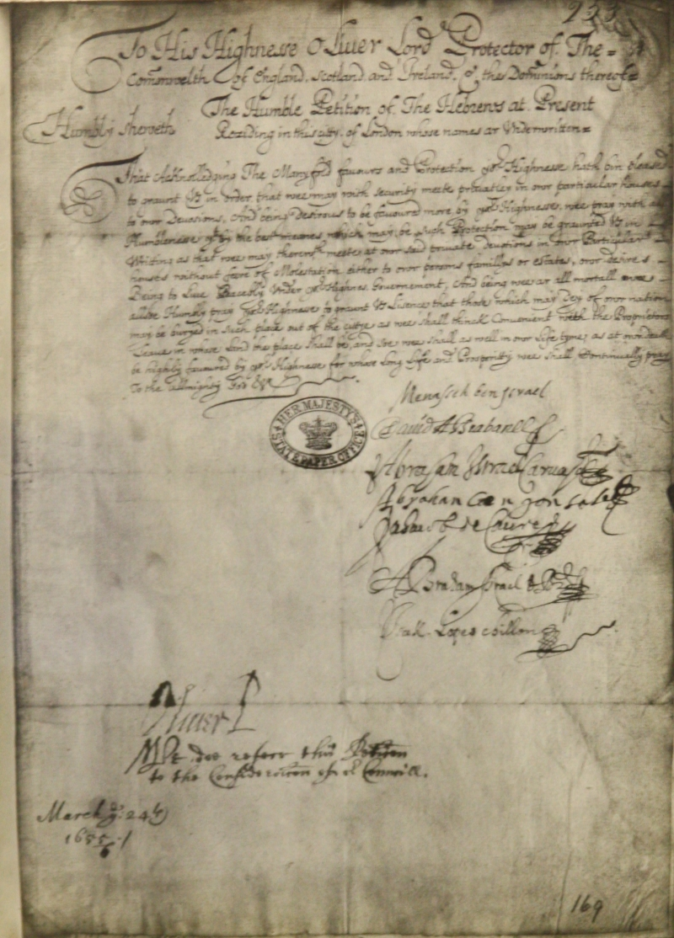
Ricardo’s theory
of comparative advantages
International trade as an advantage to all economies
The example of the Methuen Treaty between Portugal and the United Kingdom (1703)
Wine for textiles?

Slide 17
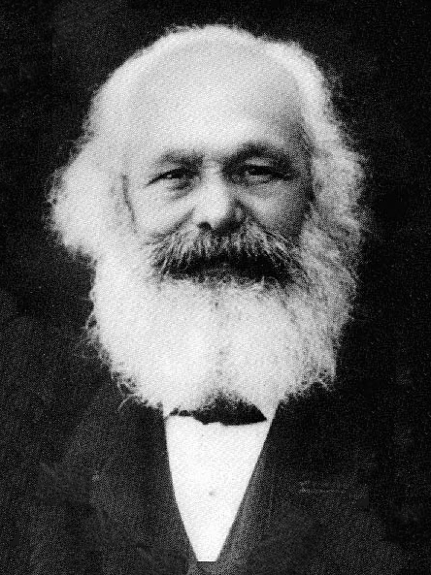
Karl Marx (1818-1883)
Theory of exploitation
Theory of social classes
Historical analysis of social formations (Antiquity, feudalism, Asiatic mode of production, capitalism)

Slide 18
Karl Marx
Biographic summary:
1818, Birth (5th may)
1841, PhD in philosophy
1842 exiled in Paris (studies economics), 1845 in Brussels and 1849 in Londres
1848 Communist Manifesto (with Engels)
1867, first volume of “Capital”
1871 “La Guerre Civil en France”
1883, death

Slide 19
Marx (the production of value)
“The labour-time materialised in the use-values of commodities is both the substance that turns them into exchange-values and therefore into commodities, and the standard by which the precise magnitude of their value is measured. The corresponding quantities of different use-values containing the same amount of labour-time are equivalents.
Regarded as exchange-values all commodities are merely definite quantities of congealed labour-time”.

Slide 20
Rate of profit
The ratio between profit (surplus, the part of value that has not been paid as wage ) and the capital that has been spent (constant and variable)
Or,
The relation between the organic composition of capital (a social and technical relation) and the surplus rate (a purely social relation)

Slide 21
Rate of profit (2)
Rate of profit = Surplus / K
            = Surplus / (Kconstant + Wages)
Or,
        = (Surplus/Wages)/(Cconstant/Wages)+1
The organic composition of capital and the surplus rate . These ratios evolve through time (tendencies and counter-tendencies).
A stylized fact: K per worker (K/L) grows at a sustained rate.

Slide 22
Rate of profit: a social process
Therefore, accumulation is a social process
Profit drives accumulation and it depends on the social relation as established in production
Difference between the owners of capital and the owners of labour.

Slide 23
How was it? Primitive accumulation of capital as a historical process (1)
“The discovery of gold and silver in America, the extirpation, enslavement and entombment in mines of the aboriginal population, the beginning of the conquest and looting of the East Indies, the turning of Africa into a warren for the commercial hunting of black-skins, signaled the rosy dawn of the era of capitalist production, (...) the chief moments of primitive accumulation.
The different moments of primitive accumulation distribute themselves now, more or less in chronological order, particularly over Spain, Portugal, Holland, France, and England.” (Capital, Vol. I, ch. 31)

Slide 24
Primitive accumulation of capital as a historical process (2)
“In England at the end of the 17th century, they arrive at a systematical combination, embracing the colonies, the national debt, the modern mode of taxation, and the protectionist system. These methods depend in part on brute force, e.g., the colonial system. But, they all employ the power of the state, the concentrated and organized force of society, to hasten, hot-house fashion, the process of transformation of the feudal mode of production into the capitalist mode, and to shorten the transition. Force is the midwife of every old society pregnant with a new one. It is itself an economic power.” (Capital, Vol. I, ch. 31)

Slide 25
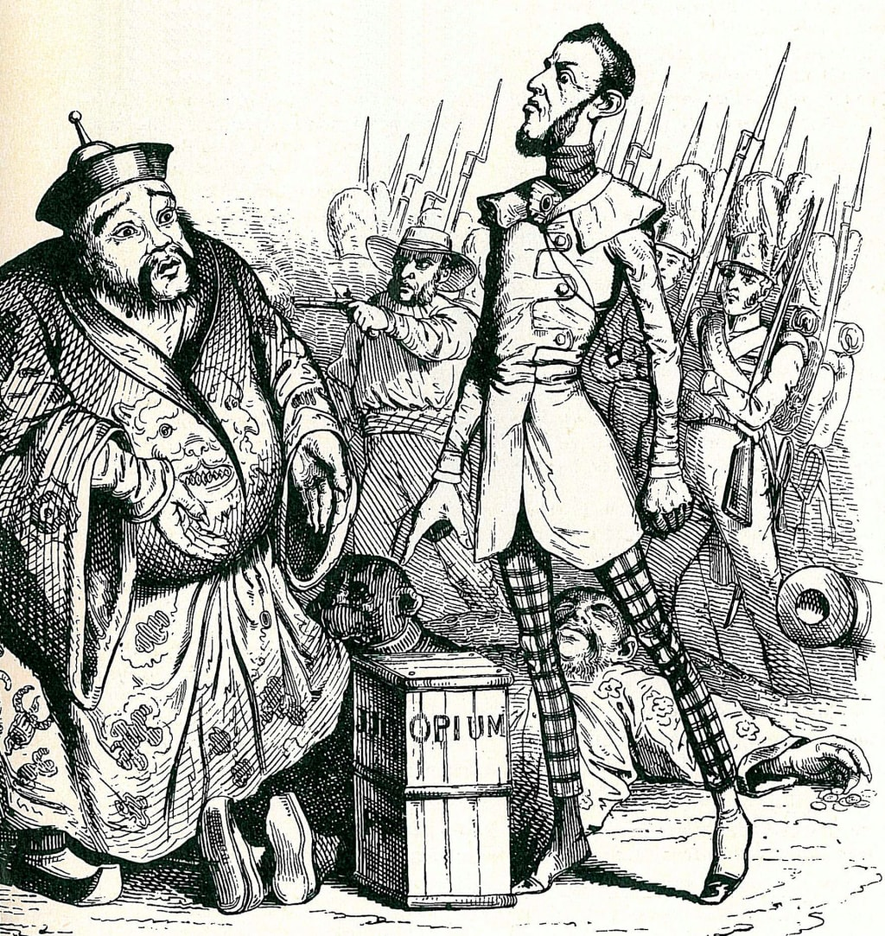
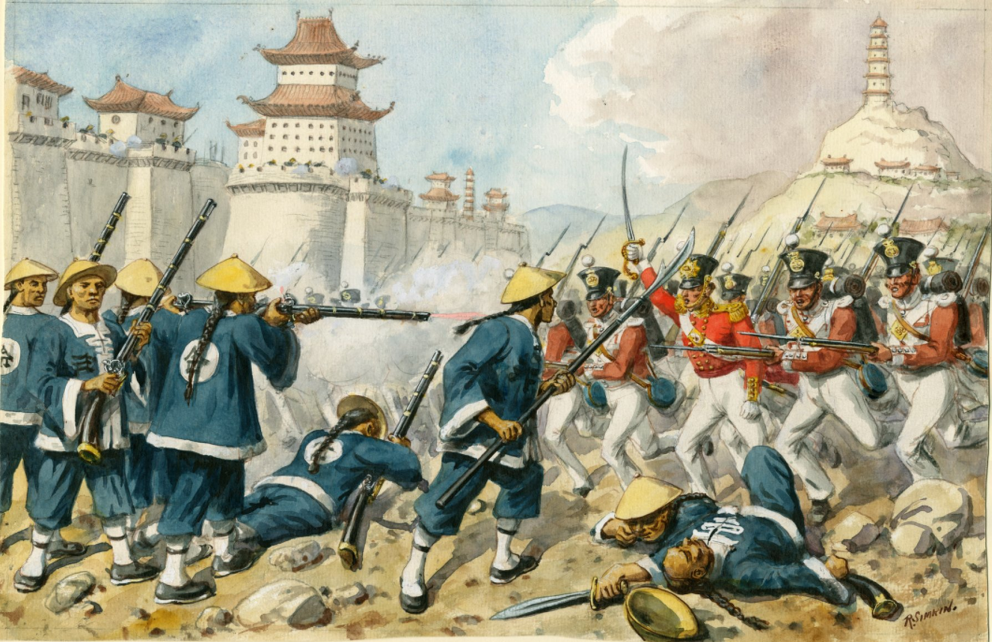
An example of imperialism:
the monopoly of the British opium trade for China
The two Opium Wars:
1839-1842
1857-1858
Hong Kong

